Slide 1
Outcomes
Understand how vaping works
Understanding the law and Ed Code
Understand the negative impacts on the body
Understand how vape is marketed towards teens
Reflection and moving forward

Slide 2
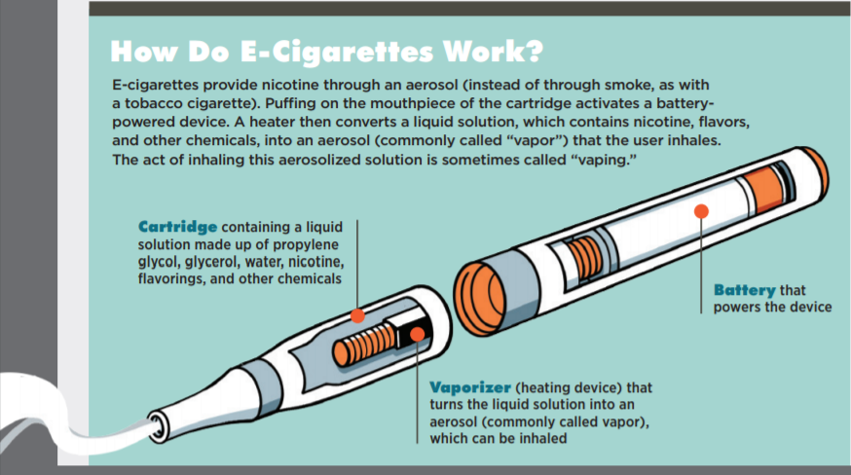
Notes:
Cartridge/reservoir – holds liquid solution – nicotine, flavorings, other chemicals
Heating Element – Vaporizer/atomizer
Power source – battery
Mouthpiece

Slide 3
Myth #1: It’s just water vapor.

Slide 4
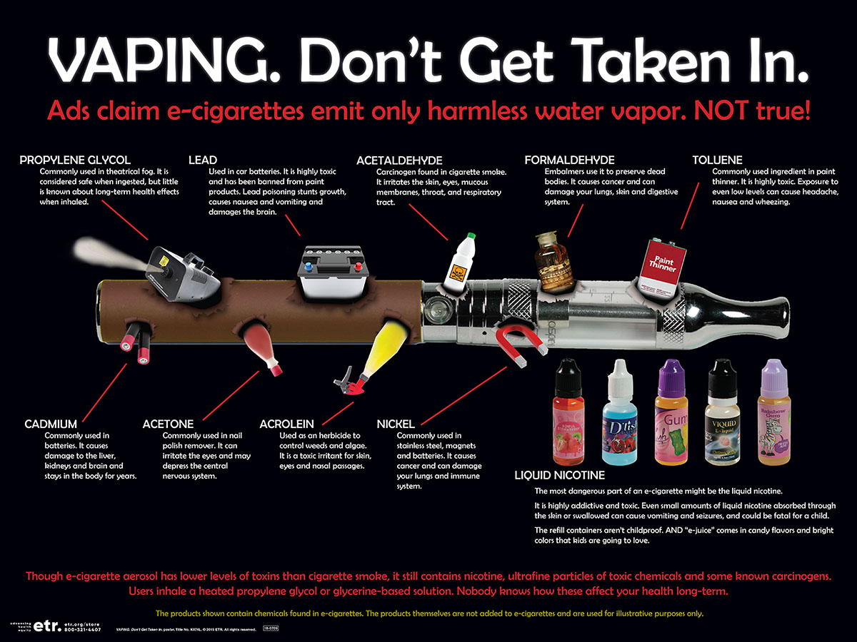

Slide 5
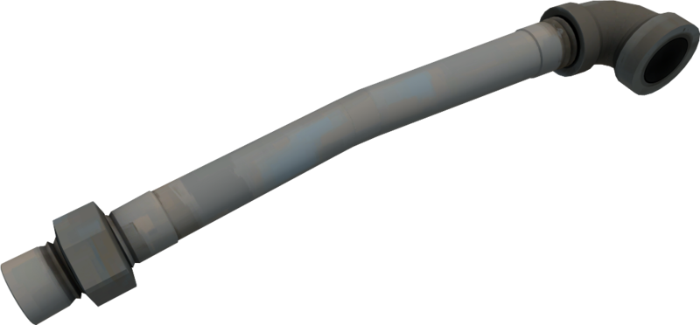
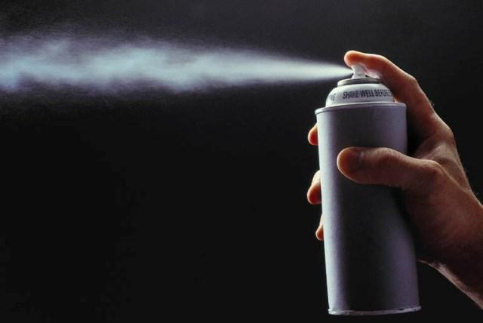
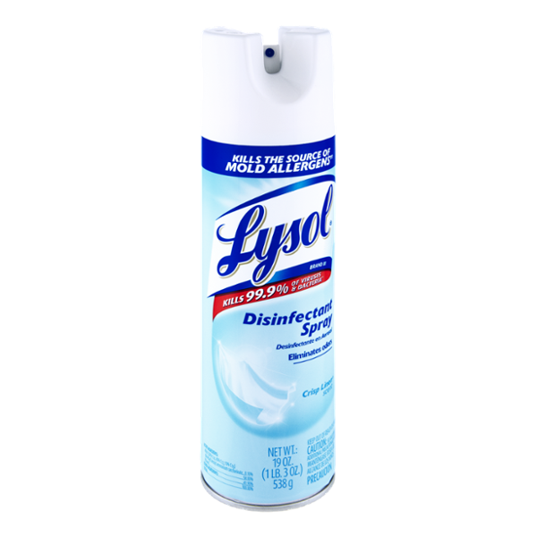
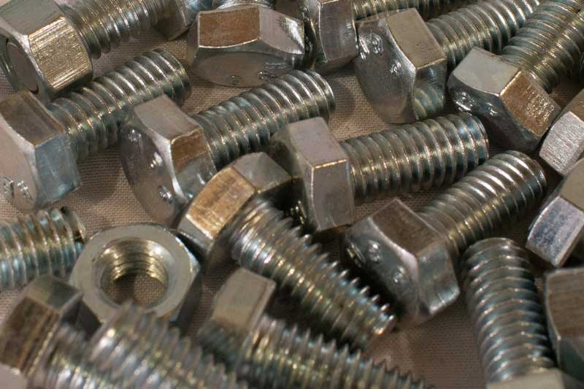
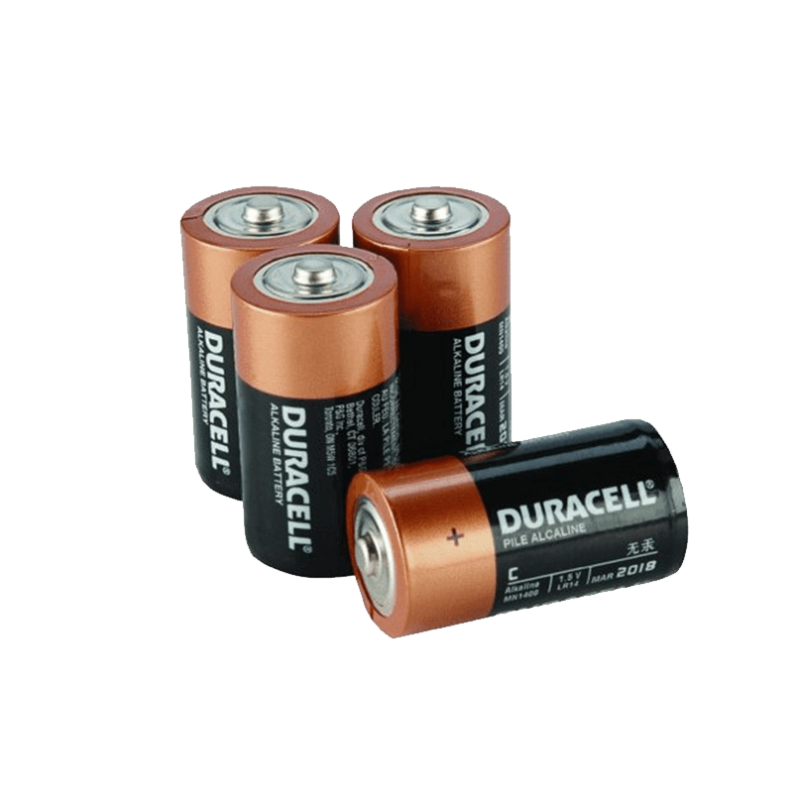
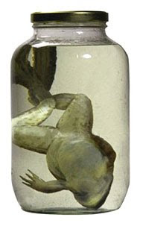

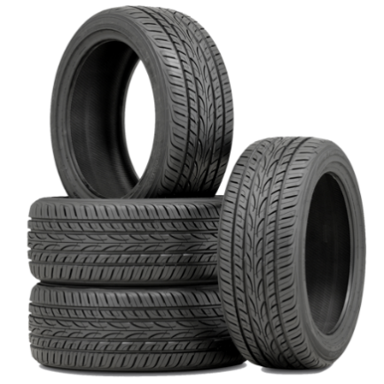
TRUTH: There are many dangerous chemicals that are created and inhaled including:
Lead
Acetaldehyde
Aerosol
Formaldehyde
Cadmium
Nickel
Isoprene
Toluene

Slide 6
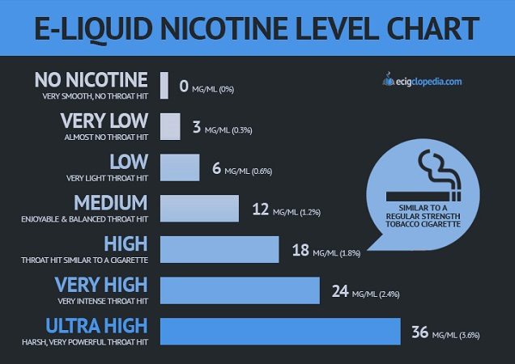

Slide 7
Myth #2: Vaping is legal.

Slide 8
TRUTH: It is illegal for minors to buy, sell, use, or possess vape pens.
48900h - Possessed or used tobacco, or products containing tobacco or nicotine products, including, but not limited to, cigarettes, cigars, miniature cigars, clove cigarettes, smokeless tobacco, snuff, chew packets, and betel.
In California, the minimum age to purchase e-cigarettes is 21
Penal Code Section 308 - It is unlawful for any person, firm, or corporation to sell, give, or in any way furnish to a minor any tobacco product or paraphernalia if that person, firm, or corporation knows or should otherwise have grounds to know that the recipient is a minor.

Slide 9
Myth #3: Vaping is not harmful to the body.

Slide 10
TRUTH: Vapors contain dangerous toxins, heavy metals, and cancer causing chemicals.
Negative impact on brain development
Cognitive impairment (how you learn)
Behavioral impairment (how you behave)
Memory
Attention
Pattern of addiction
Lung and organ damage
Acute hypertension
Heart rate increase
Lung cancer
Oral cancer
Osteoporosis
Risk of diabetes
Sleep disturbance
Stroke
Dizziness
Heart attack

Slide 11
Myth #4: The rules for marketing e-cigarettes is the same as regular cigarettes.

Slide 12
TRUTH: The same laws that don’t allow cigarette companies to advertise to kids do not apply to e-cigarettes.

Slide 13
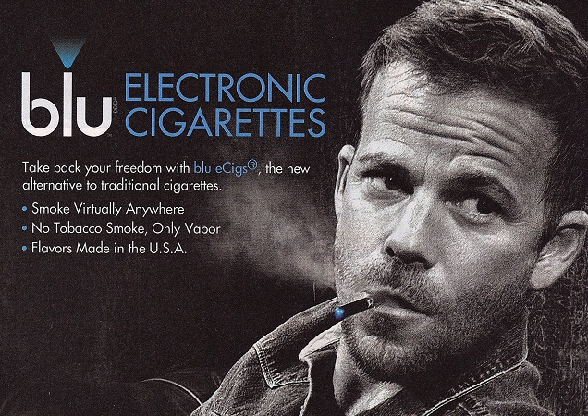



Attractive
Images

Slide 14
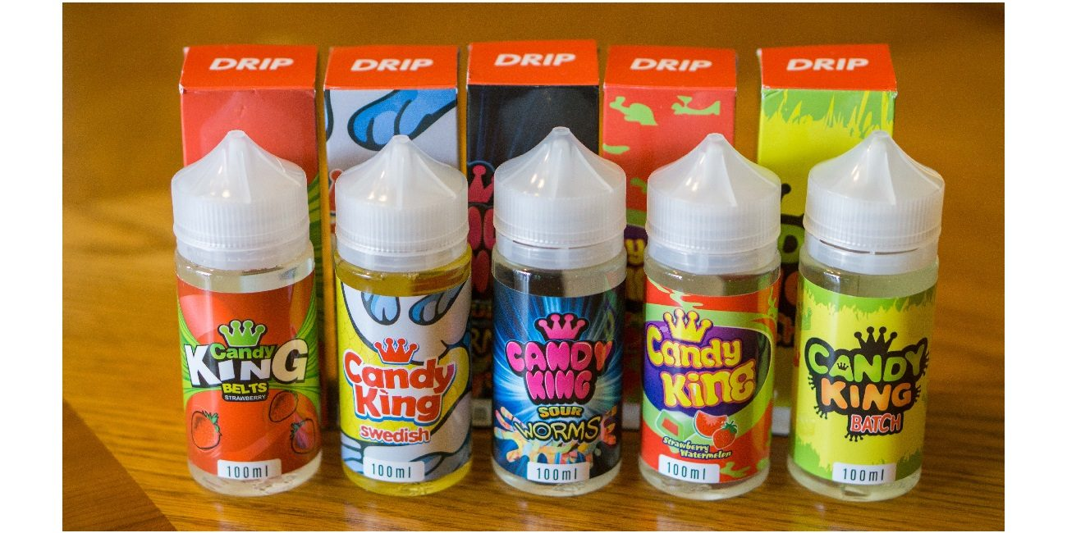


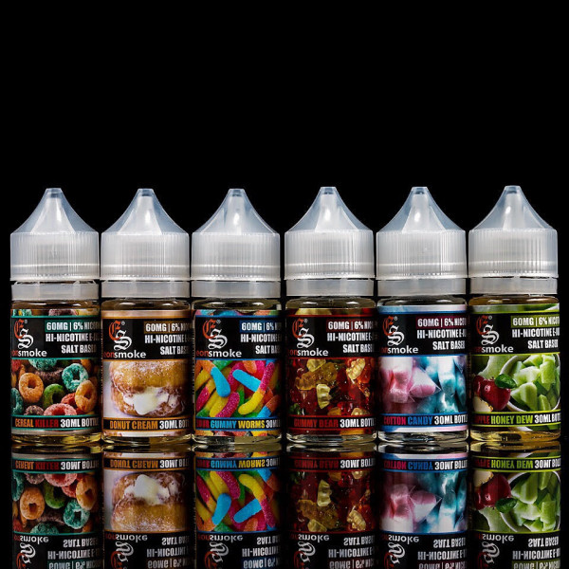
Flavorings

Slide 15
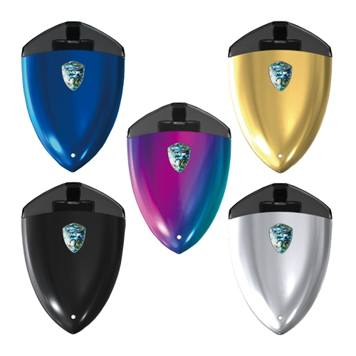
Colors, Variety, & Mods

Slide 16


Slide 17
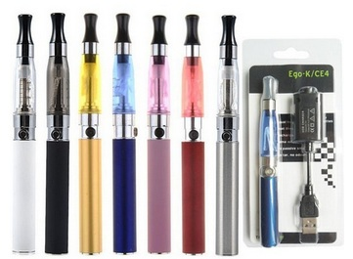

Slide 18
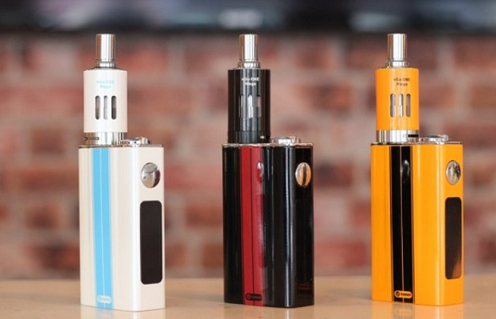

Slide 19
Myth #5: Vaping is not addictive.

Slide 20
TRUTH: Vape is not only addictive, but it lays the foundation in the brain for a life of addiction.

Slide 21
Reflections
Take 10-minutes to write a letter to your parent/child about what has happened and what you are committing to in the future.

